Slide 1
留学生管理系统招生使用手册 INTERNATIONAL STUDENTS ONLINE APPLICATION SYSTEM OPERATION MANUAL

Slide 2
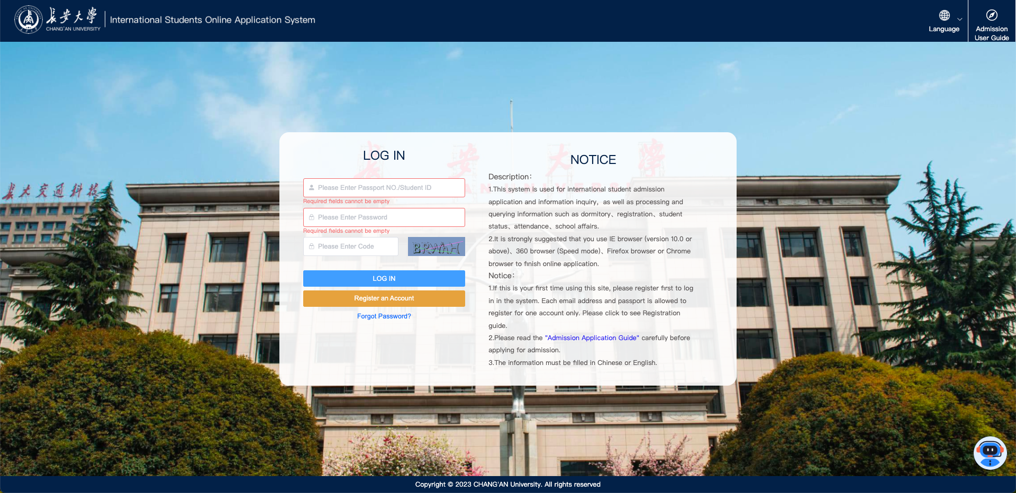
STEP1
系统地址Website address：
https://is.chd.edu.cn/#/login
1. 注册账号：点击【注册账号】按钮，根据页面提示使用护照号注册账号。如果已有账号则直接跳过此步骤进入第2步。
1.Register an account: click the [Register an account] button and register an account with your passport number according to the page prompts.If you already have an account, skip this step and go to step 2.

Slide 3
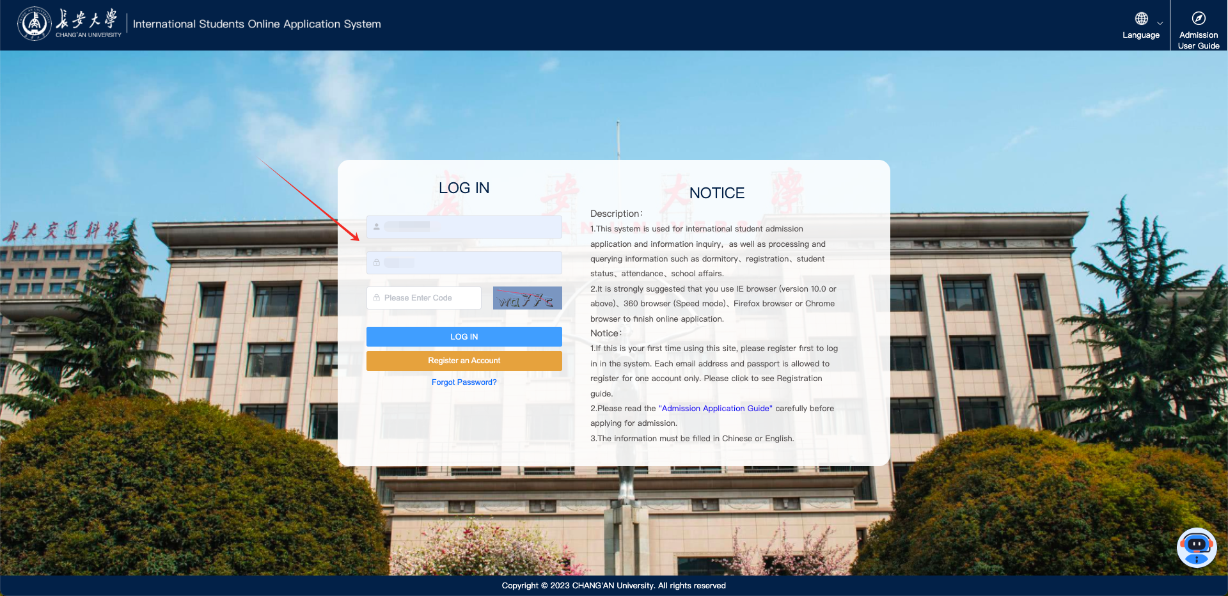
STEP2
2. 用注册的账号或已有账号，输入护照号、密码、验证码登录系统。
2. Log in to the system with the registered account or existing account, and enter the passport number, password and verification code.

Slide 4
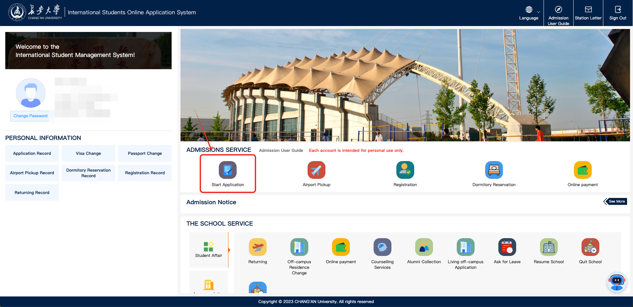
STEP3
3. 登录系统后，点击【入学申请】按钮进入申请页面。
3. After logging into the system, click the [Start Application] button to enter the application page.

Slide 5
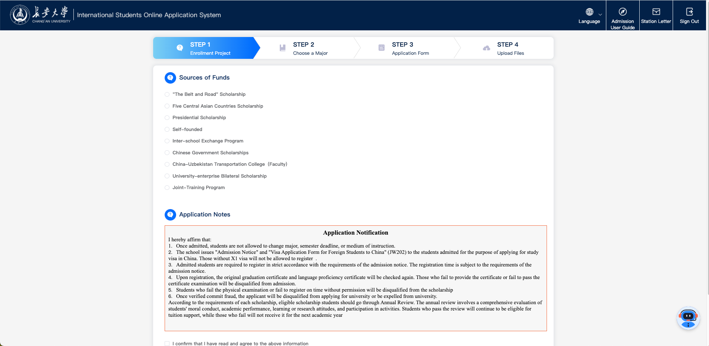
STEP4
4. 选择招生项目并阅读申请须知后，点击【下一步】按钮。
4.After selecting the enrollment project and reading the Application Notes, click [Next Step] button.

Slide 6
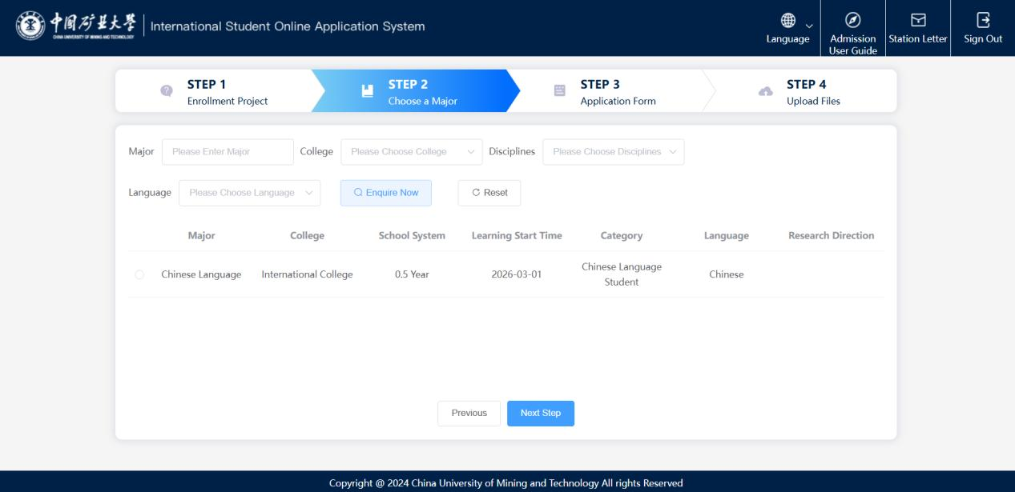
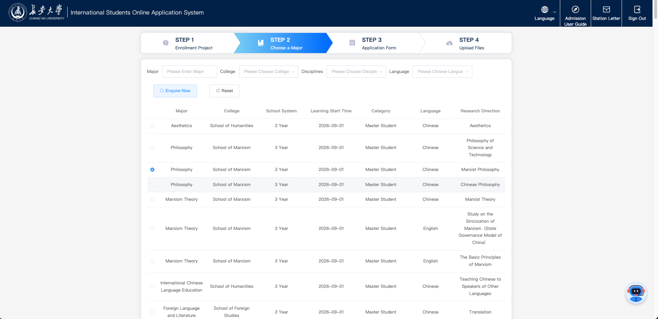
STEP5
5. 选择要申请的专业并点击【下一步】按钮。
5. Choose your intended major and click [Next Step] button.

Slide 7
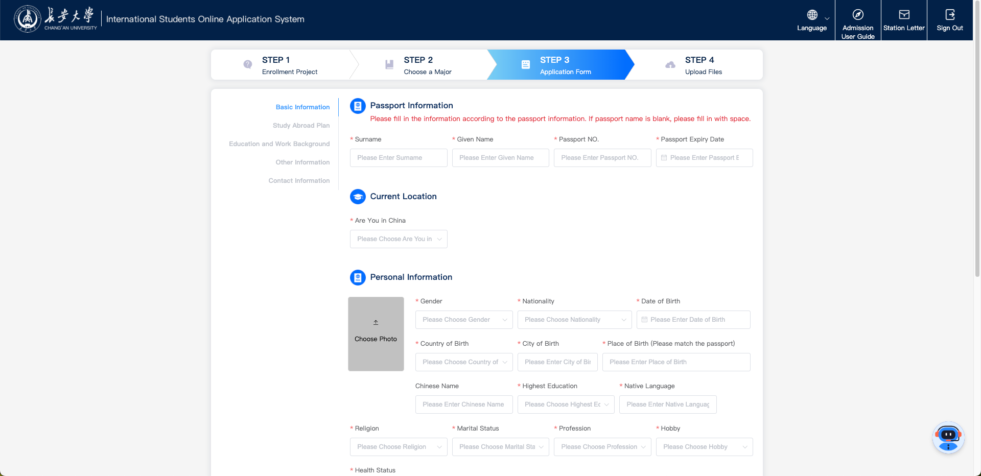
STEP6
6. 填写个人信息并点击【下一页】按钮，请确保带*是全部填写完成的。
6. Fill in basic information and click the [Next Page] button. Please ensure that all fields are filled out with an asterisk (*).

Slide 8
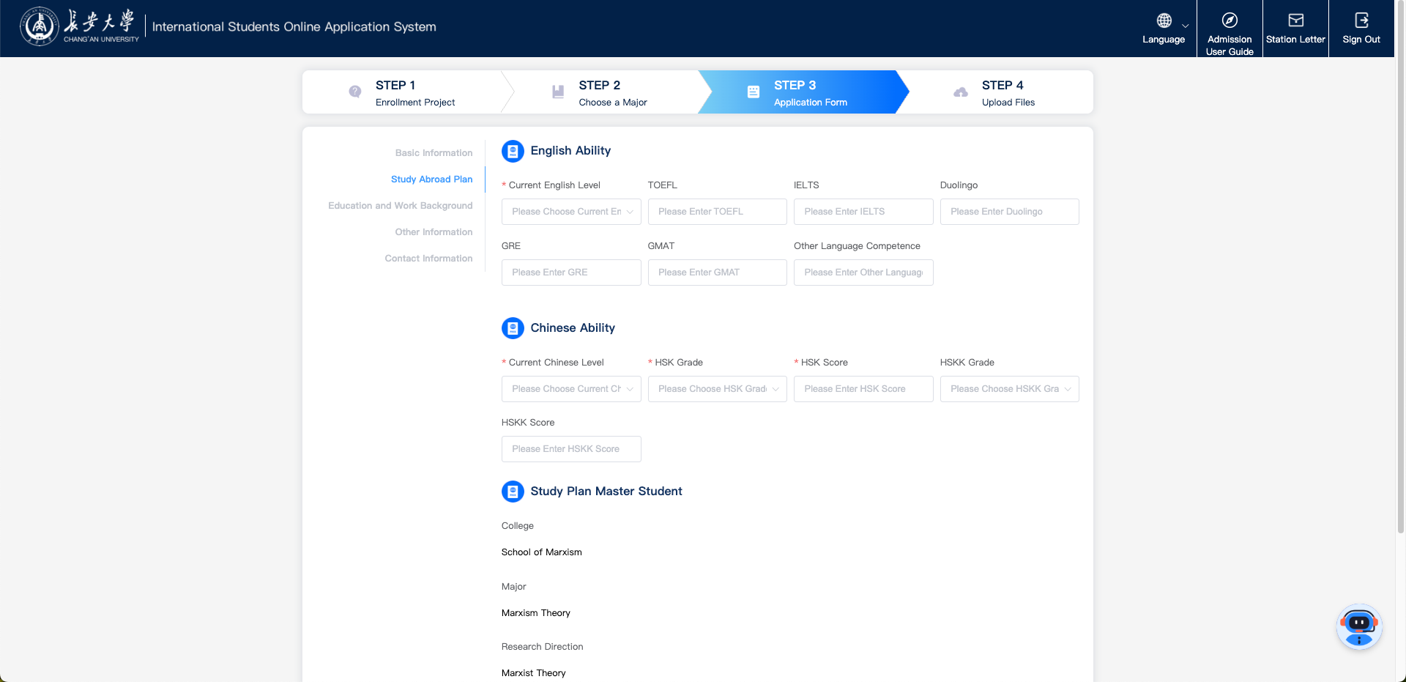
STEP7
7. 填写留学计划后，点击【下一页】按钮。
7. After filling out the study abroad plan, click the [Next Page] button.

Slide 9
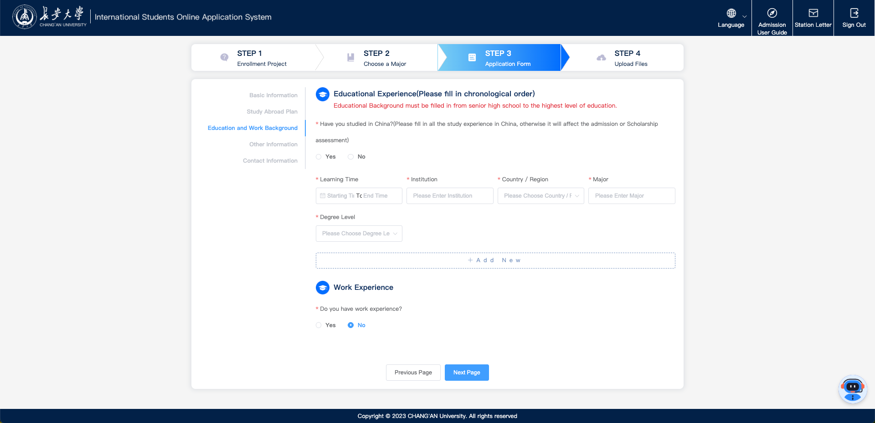
STEP8
8. 填写教育及工作背景信息后，点击【下一页】按钮。
8. After filling in the education and work background information, click the [Next Page] button.

Slide 10
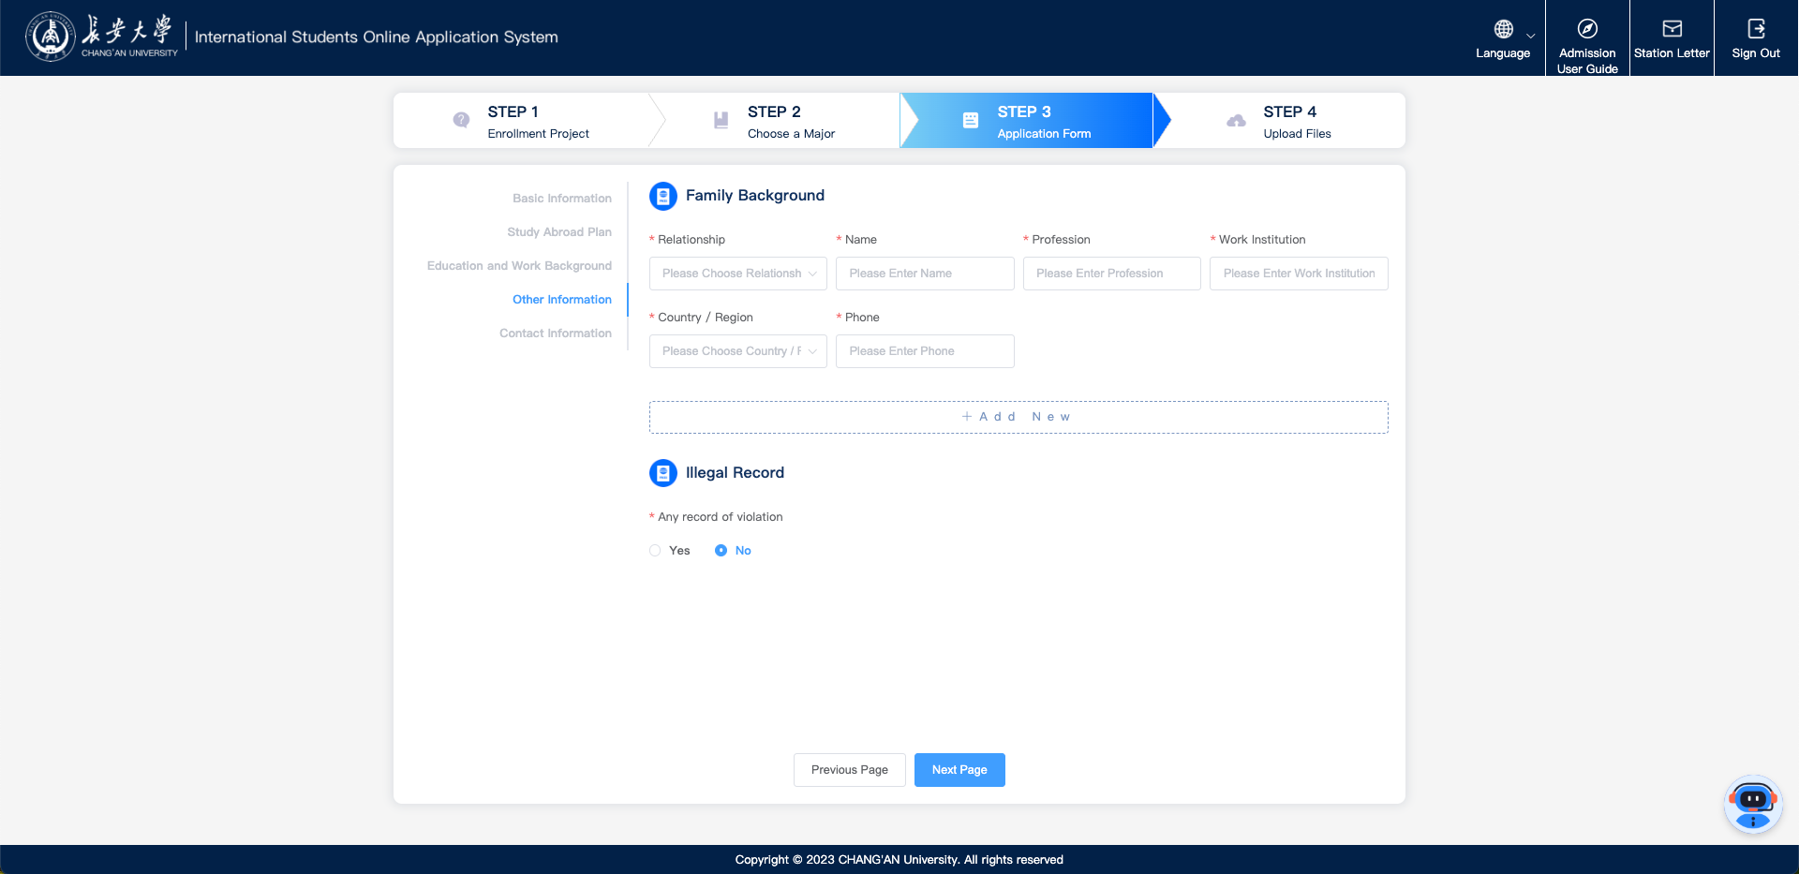
STEP9
9. 填写其他信息（家庭状况、违法记录）后，点击【下一页】按钮。
9. After filling in other information (family background, illegal record), click the [Next Page] button.

Slide 11
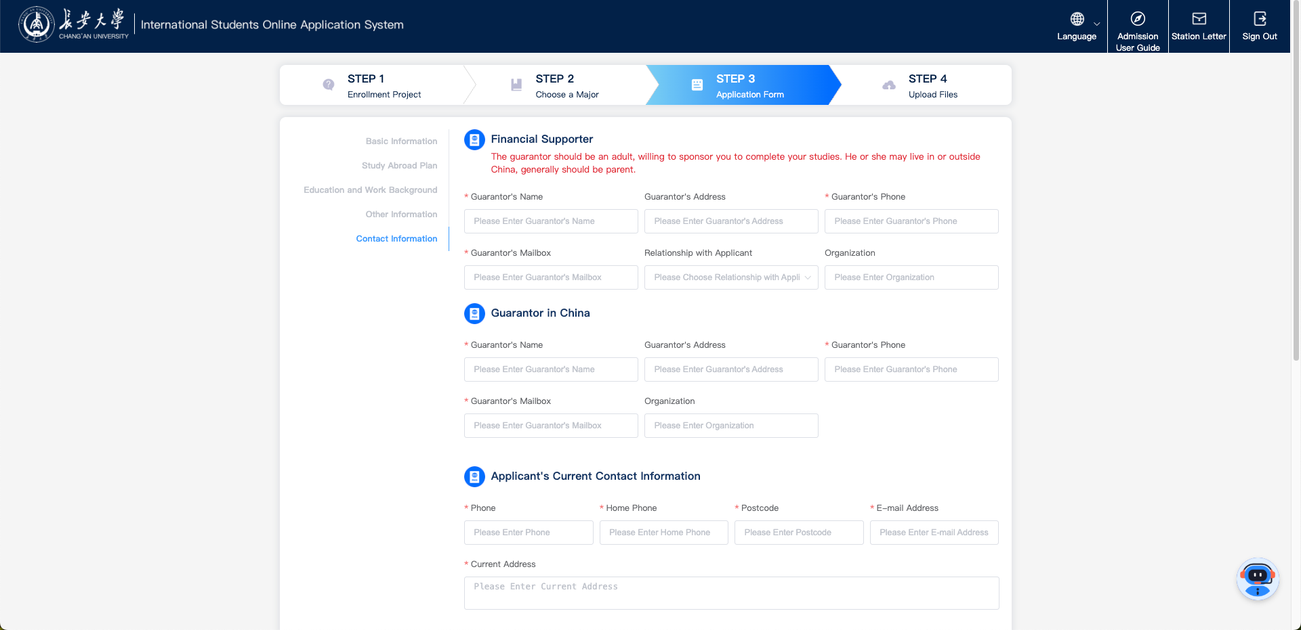
STEP10
10. 填写联系信息后，点击【下一步】按钮。
10. After filling in the contact information, click the [Next Step] button.

Slide 12
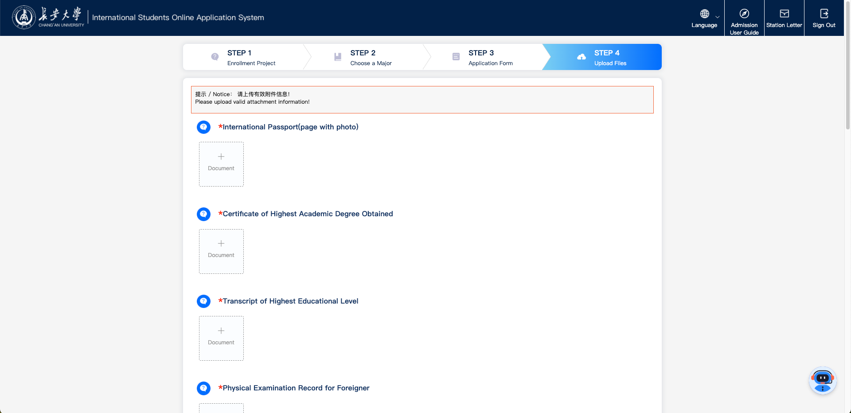
STEP11
11. 上传需要提交的附件后，点击【提交】按钮。
11.After uploading the attachments , click the [Submit] button.

Slide 13
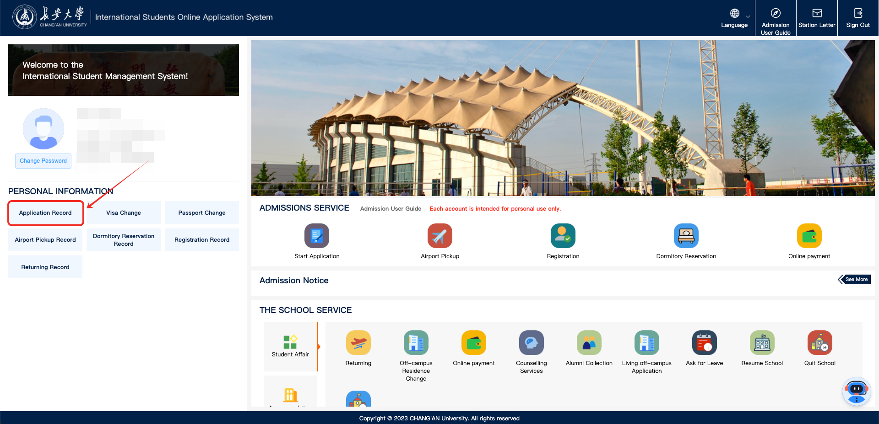
STEP12
12. 提交成功后，可以在首页的【申请记录】中点击【编辑】按钮来修改补充材料（注意：在未缴费之前可以自行补充材料，缴费之后如果需要补充材料请联系老师）。
12. After successful submission, you can click the [Edit] button in the [Application Record] on the homepage to modify the supplementary materials (note: you can supplement the materials yourself before payment, and if you need to supplement the materials after payment, please contact the teacher).

Slide 14
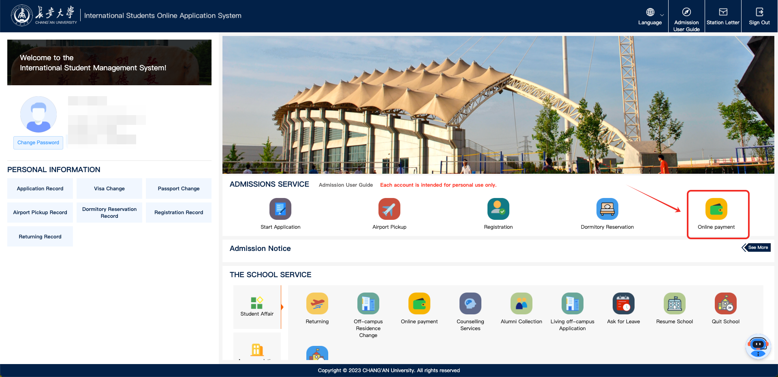
STEP13
13. 支付申请费：提交后，点击提交页面弹窗中的【立即支付】按钮，或者点击首页的【申请记录】的【立即支付】按钮，或者点击首页的招生服务的【在线支付】，都可以进入缴费平台进行线上支付。
13. Payment of application fee: After submission, click the [Immediate Payment] button in the pop-up window of the submission page, or click the [Immediate Payment] button in the [Application Record] on the homepage, or click the [Online Payment] module in the "ADMISSIONS SERVICE" on the homepage to enter the payment platform for online payment.

Slide 15

STEP14
14. 申请进度可以在首页的【申请记录】中查看。
14. The application progress can be viewed in the [Application Record] section on the homepage.

Slide 16
END

